Slide 1
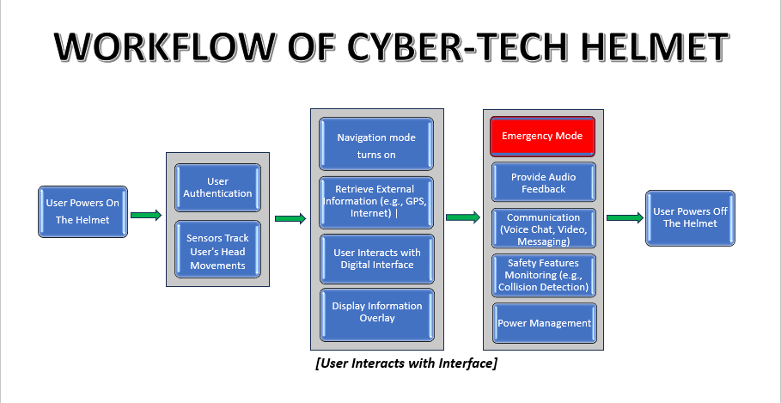

Slide 2
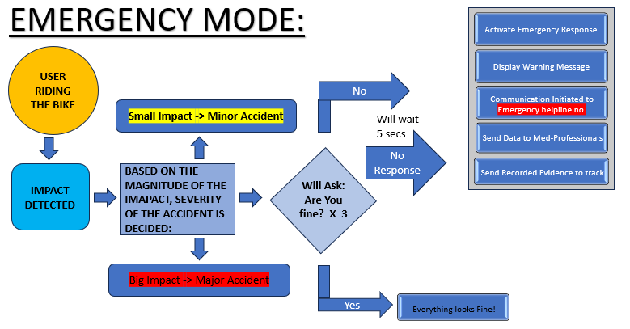

Slide 3
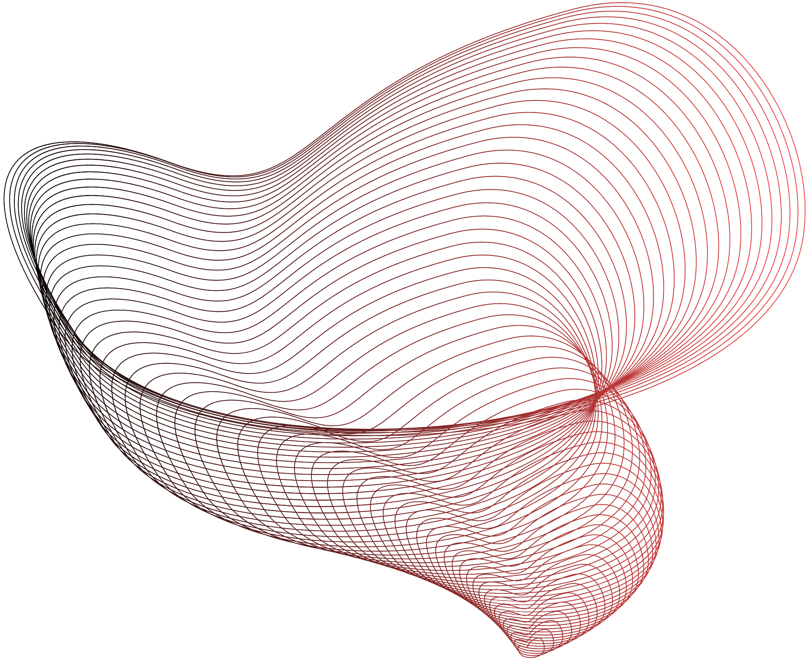


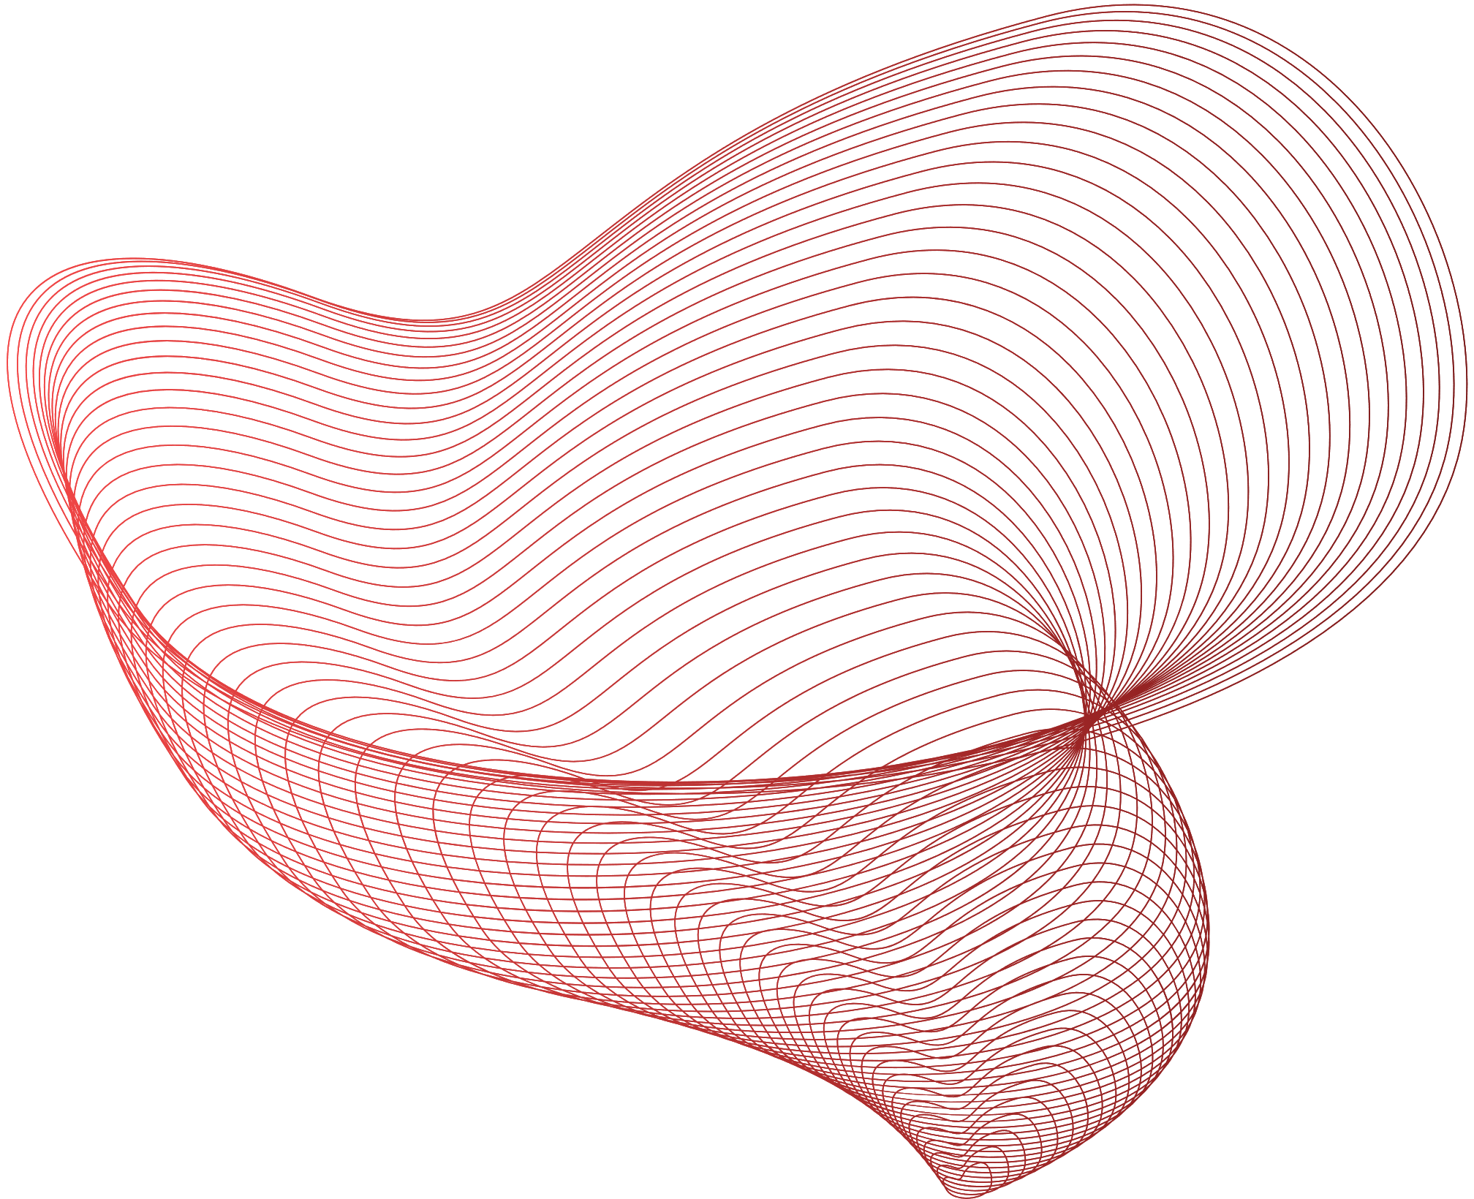

Slide 4
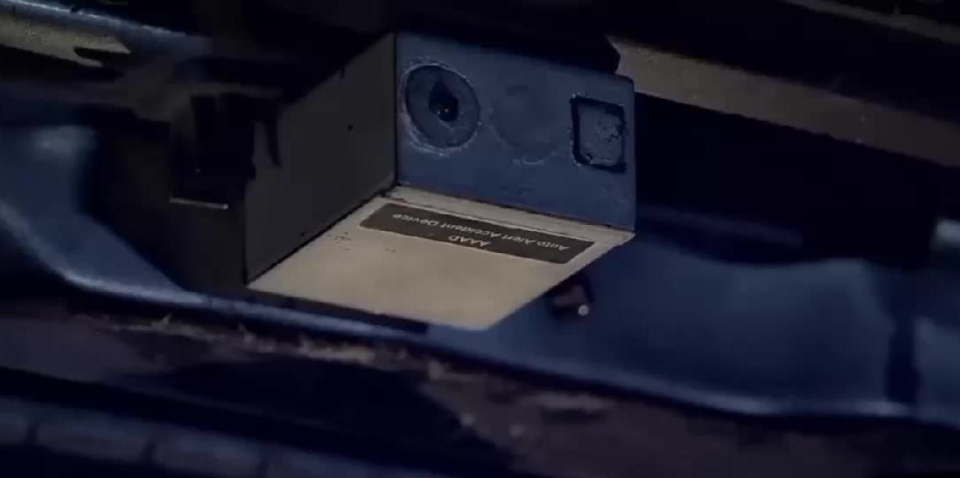

Slide 5
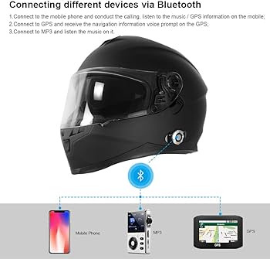
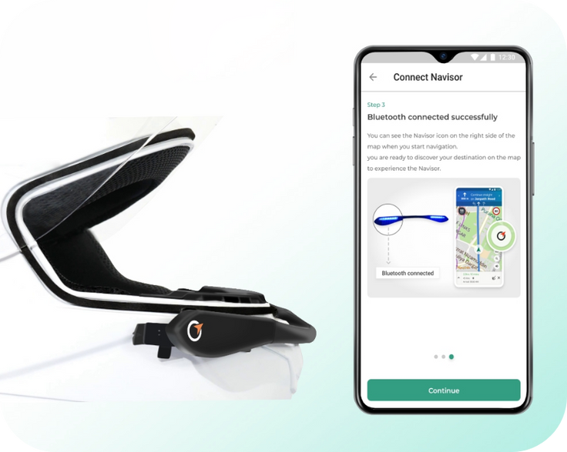
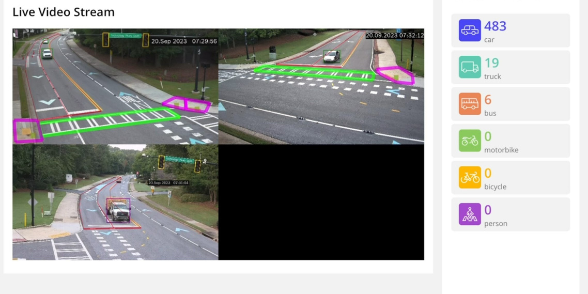
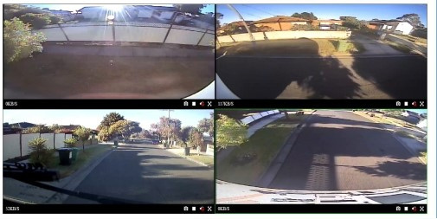


ANDROID & WEB DEVLOPMENT
To connect a Helmet to your phone :-
To access live streaming footage from website :-
App with proper google map, GPS and Bluetooth connectivity.
Turn on Bluetooth on your phone.
Turn on Helmet to Connect.
Select "Helmet Connection Option via Bluetooth" from the app list on your phone.
You should hear "CONNECTED" on your Helmet
Helmets have a microphone and speaker that allow riders to communicate with each other. Helmets also allow riders to connect to a phone, GPS, or music player
The live footage will store in cloud memory.
Select the camera as the video input device in your video conferencing software or website.
Auto Connect the camera to a mobile device .

Slide 6

TECHNOLOGY USED :
ANDROID
WEB DEVLOPMENT
Android Studio
Android SDK
XML Layout
Sensor API
Input API
OpenGL ES
AudioManager
SpeechRecognizer
Bluetooth
Wi-Fi
HTML
CSS
JavaScript
Web APIs
WebRTC
Canvas
WebGL
Responsive Design
Progressive Web App (PWA)
WebSockets
Server-Side Technologies
Security

Slide 7


AI
How it is used in cyber tech helmet?
1.Data Analytics: The AI in smart helmets can collect and analyse data on a rider's behaviour and preferences. This data can be used to personalize the riding experience and improve helmet features over time
2.Fall Detection and Emergency Response : In the event of a crash or fall, smart helmets with AI can detect the impact and send an automatic distress signal to emergency services or a pre-designated contact, providing crucial information about the rider's location.
3.Object Recognition and Collision Avoidance: AI-powered cameras and sensors on smart helmets can identify objects, vehicles, or pedestrians in the rider's path. The system can then provide alerts or even take evasive actions to prevent collisions.
4.Adaptive Noise Cancellation: AI-driven noise cancellation can filter out unwanted sounds, such as wind or traffic noise, to provide a more comfortable and safer riding experience.
5.Alerts and Notifications: AI algorithms can analyze data from sensors and cameras to detect potential hazards and send warnings to the rider. For example, the helmet can warn of a vehicle approaching from behind or a sudden change in road conditions.
6)Gesture Recognition: ML algorithms are used to recognize and interpret gestures made by the wearer, allowing for hands-free control of helmet functions. For example, a simple gesture might adjust the volume of a built-in communication system or answer a phone call.

Slide 8
TECHNOLOGY USED :
ML & Deep Learning
Python: A versatile programming language commonly used for data science and machine learning.
OpenCV: An open-source computer vision library for image and video analysis.
TensorFlow or PyTorch: Deep learning frameworks for building and training neural networks.
Scikit-learn: A machine learning library for traditional ML algorithms like regression, classification, and clustering.
NumPy and Pandas: Fundamental libraries for numerical computing and data manipulation.
high-level neural networks API that can run on top of TensorFlow or other backends.
Matplotlib and Seaborn: Libraries for data visualization.
Speech Recognition Libraries: libraries like SpeechRecognition for speech-to-text conversion.
Natural Language Processing (NLP) Libraries: language understanding capabilities, NLTK and spaCy can help with NLP tasks.

Slide 9

IOT
SENSOR AND DEVICES USES:-
Fall Sensor MPU6050
ULTRASONIC AND IR Sensor For Distance Calculation
GSM For Message Sending
GPS for current location
Arduino UNO for Control Unit
Bluetooth And Wifi
Alcohol Sensor
Speakers
L-ion Battery
Buzzer

Slide 10



Reducing the cost of a cyber tech helmet by:
1.Design Optimization:
Simplify the helmet's design without compromising safety or functionality.
Reduce the number of components and parts, as fewer parts often mean lower production costs.
Optimize the shape and size of the helmet to minimize material usage while maintaining comfort and safety.
We will provide a device which will be added to any helmet to upgrade its reliability and safety.
Consider modular designs that allow users to upgrade or replace specific components rather than buying a whole new helmet.
2.Manufacturing Efficiency:
Streamline the manufacturing process to reduce labor costs and improve efficiency.
Invest in automation and robotics where feasible to increase production speed and reduce labor expenses.
Optimize supply chain management to minimize the cost of raw materials and components.
3.Mass Production:
Increase production volume to benefit from economies of scale. Higher quantities often lead to lower per-unit production costs.
Negotiate with suppliers for bulk discounts on materials and components.
4.Standardization:
Standardize components where possible to reduce manufacturing complexity and costs.
Use common sizes and fittings to minimize the variety of parts required.
5.Collaboration:
Collaborate with research institutions, universities, and industry partners to explore cost-saving technologies and innovations.
Lean Manufacturing: Implement lean manufacturing principles to eliminate waste, reduce inventory, and improve production efficiency.

Slide 11
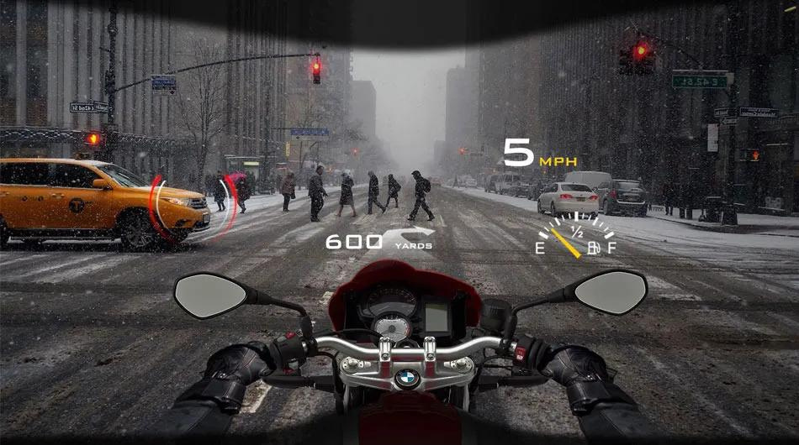

AR / VR
Implementing augmented reality (AR) in a smart helmet can provide users with real-time information and interactive experiences while wearing the helmet.
Safety Considerations:
Prioritize safety features in your smart helmet. Ensure that the user can maintain situational awareness of their surroundings while using AR.
Implement features like emergency shut-off, visibility enhancement (e.g., night vision), and impact resistance.
Connectivity and Data Integration:
If your smart helmet relies on external data sources, integrate sensors, GPS, and connectivity options (e.g., Wi-Fi, Bluetooth) to gather real-time information.
Develop software to process and display this data in the AR interface.
Head Tracking and Motion Sensors:
Implement precise head tracking using sensors like gyroscopes and accelerometers to detect the user's head movements.
Include motion sensors to track the user's body movements or gestures, if necessary.
07

Slide 12
THANK YOU

